Slide 1


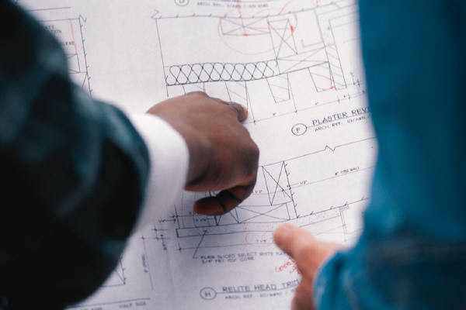
Chapter 6
Orthographic Reading

Slide 2
TOPICS
Definition
Orthographic Reading
Analysis by Solids
Analysis by Surfaces
Missing View Problems
Self Practice Problems

Slide 3

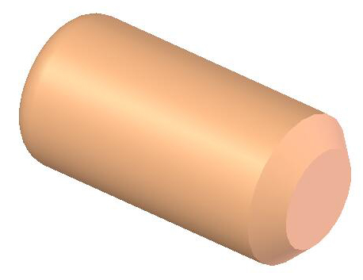
DEFINITION
Reading a drawing is the process of recognizing the shape of an object by interpreting the orthographic views.
Orthographic
Writing
Orthographic
Reading

Slide 4
VIEWING DIRECTION
Given
T.V.
L.S.V
F.V.
R.S.V
B.V.

Slide 5



ORTHOGRAPHIC READING
Analysis by Solids

Slide 6
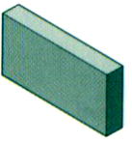

BASIC IDEA
Objects are decomposed into solid geometric
primitives.
Some of familiar solid objects
Rectangular prism
Cylinder
Negative cylinder (Hole)

Slide 7
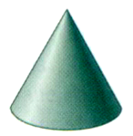
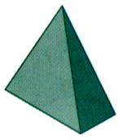
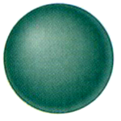
BASIC IDEA
Objects are decomposed into solid geometric
primitives.
Some of familiar solid objects
Cone
Pyramid
Sphere

Slide 8
READING STEPS
1. Orient yourself with the views given.
(Choose the viewing direction.)
2. Read the individual surfaces that appeared in
each view and related to each other.
3. Create a proper solid geometric primitive from
each reading.
4. Assembly all of solid geometric primitive
according to orthographic views.

Slide 9
EXAMPLE A
Composition
Given
Rectangular prism
Hole
Front View

Slide 10
EXAMPLE B
Given
Composition
Rectangular prism
Cylinder
Front View

Slide 11
EXAMPLE C
Given
Composition
Cylinder with a blind
hole.
L-shaped with round
end
Hole

Slide 12
EXAMPLE D
Composition
Given
Wedge

Slide 13
EXAMPLE D
Composition
Given
Wedge
L-shaped block

Slide 14
ORTHOGRAPHIC READING
Analysis by Surfaces

Slide 15
READING STEPS
1. Orient yourself with the views given.
2. Read the individual set of lines or surface that
appeared in each view and related to each
other.
An understanding in orthographic projection, i.e. meaning of lines and surfaces are almost important.

Slide 16
READING STEPS
3. Mentally create and sketch a form of the surface
that produce the same orthographic views as
those at the beginning.
4. Repeat steps 2 and 3 until all surfaces are read.
During this repeating process, the details of
an object are added up until its completed
shape is obtained.

Slide 17
GUIDANCE 1
Adjacent areas that are not in the same plane must be separated by lines.
Different plane
Same plane
Line
exists
Edge view
Edge view

Slide 18
EXAMPLE
Top view
B
All surfaces A, B and
C are not in the same
plane.
A
C
Some of possible objects’ shape.
A
A
A
B
B
C
B
C
C

Slide 19
GUIDANCE 2
Areas that show a similar shape in more than one
view is the same surface.
Similar shape

Slide 20
GUIDANCE 2
Areas that show a similar shape in more than one
view is the same surface.

Slide 21
EXAMPLE A
Similar
shape
Similar shape

Slide 22
EXAMPLE A

Slide 23
EXAMPLE A

Slide 24
EXAMPLE B

Slide 25
EXAMPLE B

Slide 26
EXAMPLE B

Slide 27
EXAMPLE B

Slide 28
EXAMPLE B

Slide 29
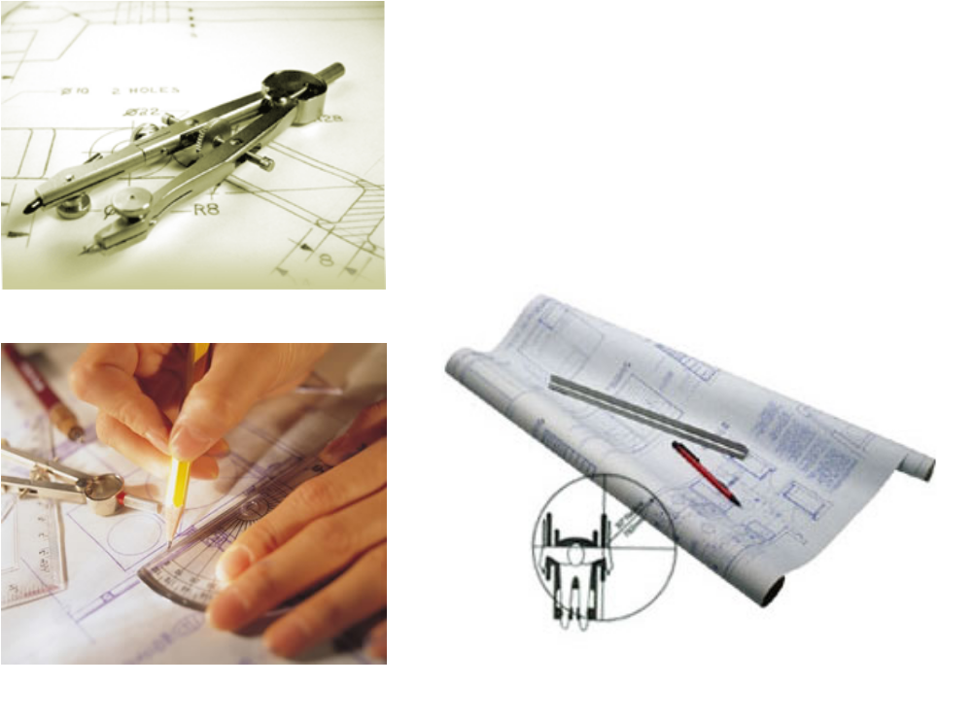


Missing View Problems

Slide 30
EXAMPLE A
Given
Previous example

Slide 31
EXAMPLE A
Given
Possible
No
Select this line

Slide 32
EXAMPLE A
Given
Possible
Select this line

Slide 33
EXAMPLE A
Given
Possible
Select this line

Slide 34
EXAMPLE A
Given
Back
Floor

Slide 35
EXAMPLE A
Given
Possible

Slide 36
EXAMPLE A
Given
Possible
Select this type

Slide 37
EXAMPLE B

Slide 38
EXAMPLE B
back
floor

Slide 39
EXAMPLE C
This area was hidden by yellow object
This line is
green surface.
?
This line is
pink surface.

Slide 40
EXAMPLE C

Slide 41
SELF PEACTICE

Slide 42
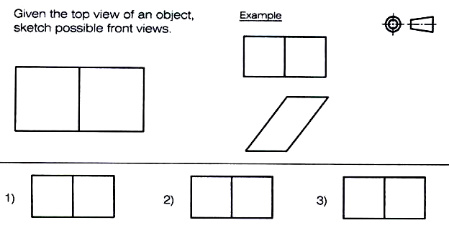

Slide 43
